Slide 1


ABOUT ME
MUZAMMIL RAHIM
BANOQABIL CIT

Slide 2

PERSONALLITY TRAITS
CONFIDENT
CARING
RESPECTFUL
SUPPORTIVE
GOOD LISTENER
CALM MIND
HARDWORKING
FRIENDLY
LEANER
POSITIVE THINKER

Slide 3
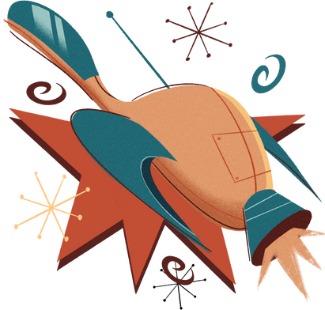
MY HOBBIES AND INTERESTS
Reading books / articles 📚
Playing sports (Circket, football etc..) 🏏⚽
Drawing 🎨
Listening to music 🎶
Traveling & exploring new places ✈️
Watching movies / dramas 🎬
Playing video games 🎮
Photography 📷
I'am Hannah Morales

Slide 4

ACADEMIC ACHIVEMENTS
Completed/Currently doing CIT (Certificate in Information Technology) course 💻
Good performance in Computer Science / IT subjects 🖥️
Participated in school projects or IT competitions (if any, even small ones) 🏅
Consistently scored well in exams. 📖
PERSONAL ACHIVEMENTS
Improved presentation & communication skills through class activities 🎤
Self-learning: Took extra time to learn cybersecurity basics online 🌐
Built strong discipline & focus while balancing studies + CIT course ⏰
Set a clear career goal to become a Cybersecurity Expert 🔒

Slide 5


SKILLS LEARNED IN CIT COURSE
💻 Strong Skills :
MS Word, Excel, PowerPoint (documentation, data handling, presentations)
Internet & Email usage (professional communication)
⚡ Basic Knowledge / Exposure :
Python Programming (basic coding & logic building)
Cybersecurity (intro to online safety & ethical hacking concepts)
Computer Hardware & Software basics

Slide 6
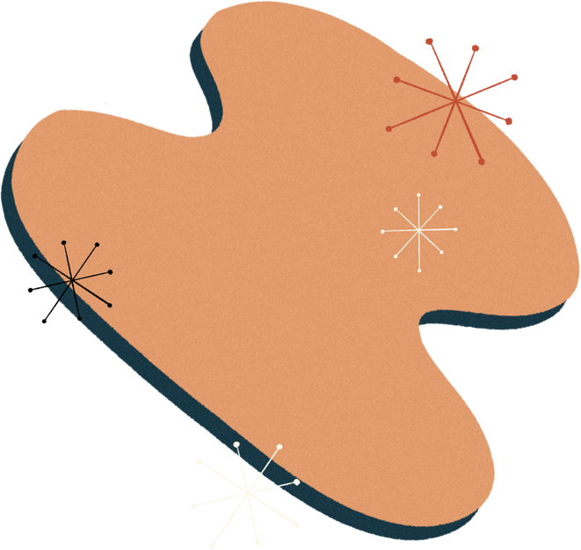
MY FAVORITE TOPIC GEOGRAPHY
Reading and following Current Affairs (staying updated with national & global news). 📰
Learning about Geography (understanding places, cultures, and the world map). 🌍
"I like to stay updated with current affairs, as it helps me understand what’s happening around the world. I also have an interest in geography, which allows me to explore different countries, cultures, and the natural features of our planet."

Slide 7
🌟 STRENGTHS :
⚡ WEAKNESSES :
Hardworking & disciplined
Quick learner (especially in IT skills)
Good communication & teamwork
Curious to learn new things
Sometimes overthink tasks
I sleep at late night
Limited practical experience in
cybersecurity (but improving)
🎯 FUTURE GOALS
“To become a Cybersecurity Expert.”
“Building a career in Cybersecurity.”
“To protect the digital world.”
“Learning and growing in Cybersecurity.”
“Aiming for excellence in IT Security.”

Slide 8
🌟 My Role Model – Hazrat Muhammad (S.A.W.)
“Hazrat Muhammad (S.A.W.) is my role model because of his honesty, patience, kindness, and leadership.”
“He (S.A.W.) taught the values of truth, justice, and mercy, which inspire me to live a good life.”
“His simplicity, strong character, and care for humanity make him the greatest example to follow.”
“I try to learn from his teachings to improve myself in both personal and professional life.”

Slide 9
Thank You
For Listening!
MUZAMMIL RAHIM

